Slide 1

CALIcon 2012:
HOW TO TEACH A BLENDED (HYBRID) COURSE
By Professor Norman M. Garland
Southwestern Law School
© 2012 Norman M. Garland

Slide 2
Overview
What is a Blended course?
Why a Blended course?
Basic Structure
Narrated PowerPoints
Quizzes
Labs/Simulations
Course Page

Slide 3

1. WHAT IS A BLENDED COURSE?

Slide 4
DEFINITION
DISTANCE LEARNING COURSE
One that involves separation of the instructor and student, usually involving on-line activity
A course that consists of some portion thereof in which the “educational process [IS] characterized by the separation, in time or place, between instructor and student.”
  ABA Standards and Rules of Approval of Law Schools, Chapter 3: Program of Legal Education, Standard 306(b)

Slide 5
DEFINITION, CONTINUED
A COURSE PRINCIPALLY OFFERED BY MEANS OF
  (1) technological transmission, including Internet, open broadcast, closed circuit, cable, microwave, or satellite transmission;
  (2) audio or computer conferencing;
  (3) video cassettes or discs; or
  (4) correspondence.

Slide 6
BLENDED (HYBRID) COURSE DISTINGUISHED
IF A COURSE IS STRUCTURED SO THAT 2/3 OR MORE OF THE “INSTRUCTION CONSISTS OF REGULAR CLASSROOM INSTRUCTION”
  THE COURSE “SHALL NOT BE TREATED AS ‘DISTANCE EDUCATION’ FOR PURPOSES OF THE ABA STANDARDS GOVERNING DISTANCE EDUCATION”
  HENCE A PARTIALLY ON-LINE COURSE STRUCTURED WITHIN SUCH PARAMETERS IS NOT SUBJECT TO ANY RESTRICTIONS THAT THE ACCREDITING AGENCIES IMPOSE UPON DISTANCE LEARNING
  SUCH PARTIALLY ON-LINE COURSES ARE “BLENDED” COURSES BLENDING SOME ASPECTS OF DISTANCE LEARNING WITH REGULAR IN-CLASS COURSEWORK
    NO SYNCHRONOUS TECHNOLOGY USED IN MY COURSE—THAT WAS LEFT FOR THE CLASSROOM

Slide 7
2. WHY A BLENDED COURSE?

Slide 8
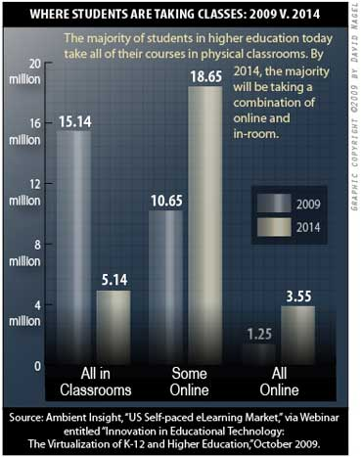
THE SHORT ANSWER TO WHY

Slide 9
MORE WHY
TRADITIONAL TEACHING METHODS FOR EVIDENCE
  ENHANCED BY TWEN, UPLOADING
    POWERPOINTS
    SUPPLEMENTAL READING MATERIALS
    ASSIGNED PROBLEMS FOR SOLUTION
      OFFERING FEEDBACK AND PRIZES FOR STUENT POSTINGS
    SOME QUIZZES
      NON-GRADED, DESIGNED TO ENHANCE LEARNING WHILE READING
STUDENT PARTICIPATION HAS BEEN CONSISTENTLY DISAPPOINTING
IN THE BLENDED CLASS, I FOLDED THE PROBLEMS INTO QUIZZES
  REQUIRED AND GRADED

Slide 10
WHY CONCLUDED
THE METHOD IS BASED ON THE NOTION OF “FLIPPING THE CLASSROOM”
  THERE ARE MANY BENEFITS FROM FLIPPING THE CLASSROOM
    STUDENTS ARE ACTIVE DURING IN-CLASS TIME, NOT PASSIVELY “RECEIVING”
    STUDENTS INTERACT WITH EACH OTHER MUCH MORE ACTIVELY
    STUDENTS HELP EACH OTHER—A LOT OF MENTORING GOES ON
    THE TEACHER CAN MONTIOR AND GUIDE GROUP PROGRESS
    THE OVERALL EFFECT IS TO HUMANIZE THE CLASSROOM
  SEE SALMAN KAHN’S TED LECTURE AT http://www.ted.com/talks/salman_khan_let_s_use_video_to_reinvent_education.html
  THE NEXT SLIDE HAS AN EXCERPT FROM THAT VIDEO

Slide 11
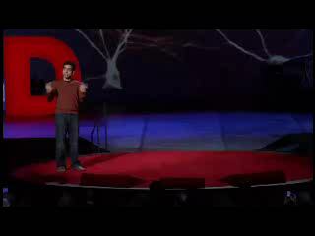
FLIPPING THE CLASSROOM

Slide 12
3. BASIC STRUCTURE

Slide 13
WEEKLY COURSE STRUCTURE

Slide 14
COURSE DURATION
TRADITIONAL EVIDENCE CLASS
  4 CREDITS, 14 WEEKS, 3 @ 1 HOUR 20 MINUTE CLASS SESSIONS
BLENDED CLASS
  4 CREDITS, 10 WEEKS, 2 IN-CLASS SESSIONS @ 2 HOURS + ON-LINE CLASS THAT = THIRD CLASS SESSION (USALLY MORE THAN 2 HOURS)
  OVERALL CREDIT HOURS COVERED IN 10 WEEKS EXCEEDS THE REQUIRED HOURS FOR A 4 UNIT CLASS
WHY THIS STRUCTURE/DURATION?
  THE PURSUIT OF ADVENTURE TRAVEL CAN BE THE MOTHER OF NECESSITY TOO

Slide 15
4. NARRATED POWERPOINTS

Slide 16
CONVERSION OF EXISTING PPTs
GRAPHICAL PRESENTATIONS R US
MY POWERPOINT BANK
  CONVERTED TO NARRATED POWERPOINTS
  USING CAMTASIA
GOAL TO TALK LIKE I WOULD IN CLASS
  BUT WITHOUT STUDENT INTERACTION
  SO I INCLUDED MUCH MORE DETAILED NARRATIVE OF CASES AND MATERIALS
    I ASKED QUESTIONS AND GAVE ANSWERS TOO
EFFECT OF PRODUCING THE POWERPOINTS
  REFRESHING MY MATERIALS
  RETHINKING THE COURSE AS A WHOLE
TIPS
  HOW TO PAUSE AND COVER MISTAKES USING CAMTASIA
  NOT TO USE PAGE NUMBER REFERENCES IN THE BODY OF A SLIDE
    THAT MAKES THE PPT USABLE OVER TIME WHEN CASEBOOK EDITIONS CHANGE

Slide 17
A BIT MORE ON NARRATED POWERPOINTS
STUDENT RESPONSE
  OVERWHELMINGLY POSITIVE
  STUDENT EVALUATION COMMENTS
    ALL BUT ONE (OUT OF 16) LOVED THE POWERPOINTS
PREPARE THE ENTIRE POWERPOINT COURSE COVERAGE IN ADVANCE
  HAVE THEM ON THE SHELF BEFORE THE CLASS BEGINS
  THIS FREED UP MY TIME SO I COULD DEVOTE MY EFFORTS TO STUDENTS AND TEACHING
  MAKE ALL THE MATERIALS AVAILABLE TO THE STUDENTS FROM THE BEGINNING

Slide 18
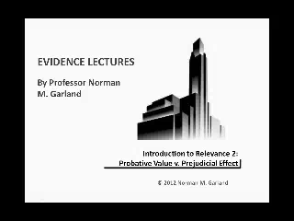
A SAMPLE OF A NARRATED POWERPOINT

Slide 19
5. QUIZZES

Slide 20
QUIZ STRUCTURE
THE WALTZ, PARK, & FRIEDMAN CASEBOOK HAS “HYPOTHETICAL” PROBLEMS AT THE END OF MOST CHAPTERS AND SUB-CHAPTERS
  I CONVERTED MANY OF THEM INTO MULTIPLE CHOICE AND TRUE FALSE QUESTIONS IN QUIZ FORMAT
  THE QUIZZES WERE ASSIGNED TO BE TAKEN ON-LINE AT THE CONCLUSION OF THE READING ASSIGNMENT FOR THE MATERIAL COVERED
  STUDENTS LOG INTO THE COURSE PAGE AND TRIGGER THE PERTINENT QUIZ, THEN THE QUIZ TIMER BEGINS
  AFTER CONCLUDING THE QUIZ, THE EFFORT IS GRADED AND FEEDBACK IS AVAILABLE
    GIVING THE CORRECT ANSWERS WITH EXPLANATION
    THE GRADED QUIZZES COMBINED COUNTED 10 % OF THE FINAL GRADE FOR THE COURSE

Slide 21
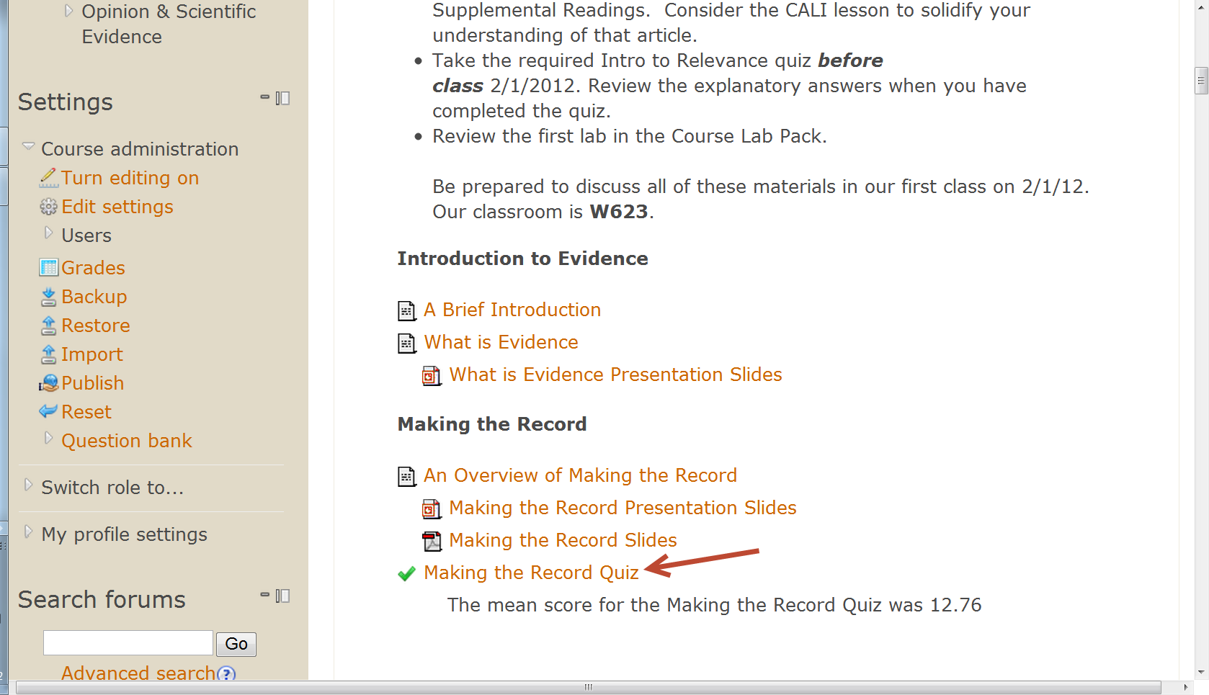
MORE ON QUIZ STRUCTURE
HERE IS A SCREEN SHOT OF THE COURSE PAGE INDICATING THE ACCESS TO THE FIRST QUIZ, MAKING THE RECORD QUIZ (INDIATED BY RED ARROW)

Slide 22
MORE ON QUIZZES
SOME QUIZZES WERE DESIGNATED “READING” QUIZZES AND DID NOT COUNT TOWARD THE FINAL GRADE
ALSO IN SOME INSTANCES STUDENTS COULD DO PRACTICE QUESTIONS BEFORE TAKING THE QUIZ THAT COUNTED TOWARD THE FINAL GRADE
  THERE WERE TWO QUIZZES OF THIS SORT, BOTH RELATING TO HEARSAY
  THE FIRST TESTED THE STUDENTS’ UNDERSTANDING OF THE DEFINITION OF HEARSAY
  THE QUESTIONS FOR THIS QUIZ COME FROM A CLASSIC SET FROM A HARVARD LAW EXAM FROM 1960-61 GIVEN BY PROF. McNAUGHTON
    THIS AND ANOTHER SET OF HARVARD LAW QUESTIONS ARE INCLUDED IN THE CASEBOOK AND HAVE BEEN WIDELY DISTRIBUTED BY EVIDENCE TEACHERS
    THESE QUESTIONS ARE ALSO INCLUDED IN MY CALI LESSON, 9 STEP ANALYTICAL GUIDE TO RELEVANCY AND HEARSAY
  I CREATED A BANK OF ALL THE QUESTIONS (MORE THAN 70)
    WHEN STUDENTS TOOK THE PRACTICE VERSION, THEY WERE PRESENTED WITH TEN OF THE QUESTIONS FROM THE BANK AND THEY COULD PRACTICE AS MUCH AS THEY WANTED
    WHEN READY TO TAKE THE QUIZ FOR “REAL,” THE STUDENT WAS PRESNTED WITH TEN QUESTIONS FROM THE BANK SELECTED RANDOMLY
    HENCE THE STUDENT MIGHT ENCOUNTER QUESTIONS NEVER SEEN BEFORE IN PRACTICE, OR MIGHT ENOUNTER QUESTIONS PREVIOUSLY SEEN
    IT SEEMS THAT MOST STUDENTS TOOK THE PRACTICE QUIZZES ENOUGH TO ENSURE THAT THEY SAW ALL OF THE QUESTIONS

Slide 23
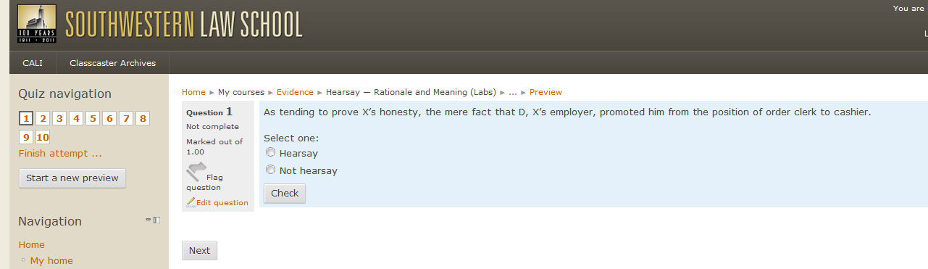
QUIZ STRUCTURE CONTINUED
  HERE IS A SCREEN SHOT OF THE HEARSAY RATIONALE PRACTICE QUIZ

Slide 24
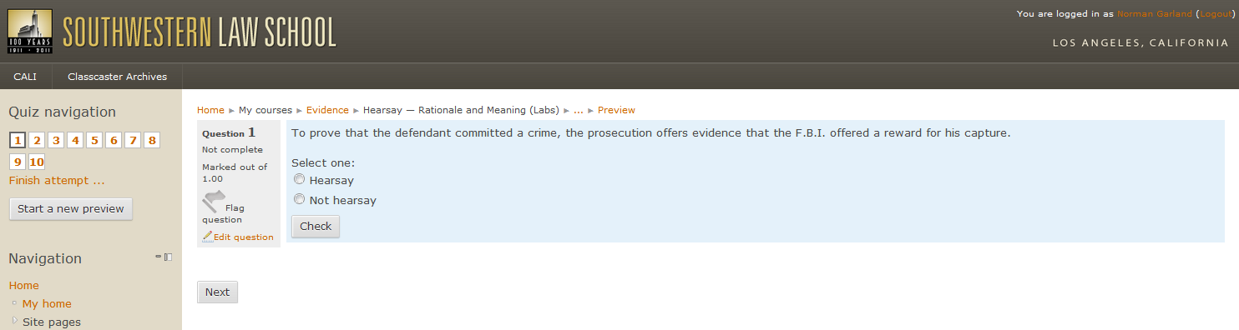
MORE QUIZ STRUCTURE
HERE IS THE SCREEN SHOT OF THE SECOND TRY AT THE PRACTICE QUIZ
  NOTE THAT THE QUESTION PRESENTED HAS CHANGED

Slide 25
QUIZZES: FINAL POINTS
STUDENT REACTION TO QUIZZES WAS VERY POSITIVE
THE COMMON COMMENT WAS THAT THE QUIZZES ENABLED THEM TO STAY ON TOP OF THE MATERIAL
CERTAINLY, HAVING FEEDBACK DURING THE PROGRESS OF THE SEMESTER IS VALUABLE TO THE STUDENTS
HAVING EVEN A TEN PERCENT CONTRIBUTION TO THE FINAL GRADE GAVE STUDENTS A SENSE OF SATISFACTION
I THOUGHT THAT ASSIGNED, GRADED QUIZZING ELEVATED THE CLASSROOM WORK

Slide 26
5. LABS/SIMULATIONS
How to Teach A Blended Course

Slide 27
LABS/SIMULATIONS BASIC STRUCTURE
I DESIGNED THE TWO IN-CLASS SESSIONS EACH WEEK AS LABS
  WITH PROBLEMS ASSIGNED FOR ANALYSIS AND SIMULATION
I ASSIGNED STUDENTS TO WORK TOGETHER IN FOUR-PERSON TEAMS
  EITHER AS PROPONENT OR OPPONENT OF THE EVIDENCE INVOLVED IN THE PROBLEM
  TWO MEMBERS OF EACH TEAM WERE DESIGNATED TO BE STAND-UP PRESENTERS IN THE SIMULATION ON DAY TWO
I ASSIGNED ONE STUDENT FROM THE CLASS TO ACT AS WITNESS IN THE PROBLEM SCENARIO
  THE WITNESS WAS FROM AMONG THE ASSIGNED GROUPS, BUT NOT FROM AMONG THE PRESENTERS

Slide 28
MORE BASIC STRUCTURE
THE FIRST IN-CLASS SESSION COMPRISED TWO PARTS
  PART ONE WAS TEAM BREAK OUT DISCUSSION AND PREPARATION
    DURING THIS FIRST PART, I WANDERED AROUND AND MONITORED THE GROUPS’ PROGRESS, ANSWERING QUESTIONS, GIVING HINTS, AND TAKING NOTE OF THE GROUP DYNAMICS
    AS STATED IN THE KAHN TED LECTURE, STUDENTS TOOK THE PARTS PREDICTED
      THOSE STUDENTS WHO WERE ON TOP OF THE SUBJECT MATTER LED THE OTHERS THROUGH THE PROBLEM, IN MANY INSTANCES MOVING THE GROUP TO THE SOLUTIONS I HAD HOPED FOR IN DESIGNING THE PROBLEM
  PART TWO WAS WITNESS INTERVIEW OR “DEPOSITION” AS IT DEVELOPED
    THE WITNESS TOOK THE STAND AND THE REMAINING CLASS MEMBERS CONDUCTED A Q & A IN THE NATURE OF AN INTERVIEW
    THIS PART OF THE WORKSHOP EVOLVED INTO SORT OF A DEPOSITION
      MEANING THAT THE WITNESS’S ANSWERS WERE CONSIDERED “ON THE RECORD” FOR USE IN THE SIMULATION SESSION ON DAY TWO
      THIS PART OF THE PROCESS PROVED TO BE EXCEPTIONALLY HELPFUL
      IN MOST INSTANCES, THE CLASS MEMBERS COULD HAVE GONE ON FOR LONGER THAN THE CLASS HOUR
    ALL CLASSES WERE RECORDED AND THE RECORDINGS WERE POSTED ON CLASSCASTER
      SO STUDENTS COULD REVIEW THE “DEPOSITION” SESSION BEFORE COMMENCING THE SIMULATION NEXT CLASS SESSION

Slide 29
MORE STRUCTURE: THE SIMULATION SESSION
DURING THE SECOND IN-CLASS SESSION, THE CLASS MET IN A MOCK TRIAL SETTING
  COUNSEL PROCEEDED TO PRESENT AND OPPOSE THE EVIDENCE INVOLVED IN THE ASSIGNED PROBLEM
  IN MANY INSTANCES, COUNSEL BEGAN BY MOVING IN LIMINE, WHICH MEANT THAT THE MAJOR PRESENTATION CONSISTED OF ARGUMENTS ON THE MOTION
  BUT, IN ANY EVENT, MOST SIMULATED PROBLEMS ALSO EXTENDED INTO THE PRESENTATION OF THE EVIDENCE AND CROSS-EXAMINATION OF THE WITNESS
  I DESIGNED THE SIMULATIONS TO FOCUS ON ONE MAJOR ASPECT OF A SUBJECT
    SUCH AS THE DEFINITION OF HEARSAY OR THE HILLMON DOCTRINE IN THE STATE OF MIND EXCEPTION TO THE HEARSAY RULE

Slide 30
SIMULATION RESULTS
LEARNING BY APPLICATION OF PRINCIPLE TO CONCRETE PROBLEMS, THE CORE GOAL OF SIMULATIONS, PROVED TO BE AS REWARDING AS PREDICTED
  STUDENT RESPONSE TO THIS STRUCTURE OF AN EVIDENCE CLASS WAS EXCEPTIONALLY POSITIVE
  AS ONE STUDENT PUT IT:
    “AFTER TAKING EVIDENCE IN THIS FORMAT, IT’S DIFFICULT TO IMAGINE LEARNING THE SUBJECT ANY OTHER WAY. AFTER ARGUING THE OBJECTIONS, THE LAW IS SO MUCH EASIER TO UNDERSTAND AND REMEMBER.”
      A COMMENT FROM ANONYMOUS STUDENT EVALUATIONS OF THE CLASS

Slide 31
GRADING SIMULATIONS
I GRADED THE STUDENTS’ PERFORMANCES IN THE SIMULATIONS AND THAT COUNTED 15 % OF THE FINAL GRADE
  I DID NOT GIVE A GRADE TO THE STUDENTS WHO PERFORMED AS WITNESSES, BUT I WISH I HAD—NEXT YEAR I PLAN TO DO SO
HERE IS THE GRADING GRID I USED BASED ON A SIMPLE RUBRIC THAT I DEVELOPED:
Number of points | 0 | 1 | 2 | 3
Preparation | Clearly Unprepared | Minimally Prepared | Adequately Prepared | Well Prepared
Presentation | Ineffective | Somewhat Effective | Good | Excellent
Responsiveness | Nonresponsive | Somewhat Responsive | Adequately Responsive | Very Responsive
Analysis | No Analysis Evident | Minimal Analysis Evident | Adequate Analysis Evident | Excellent Analysis
Demeanor | Poor Demeanor | Shaky, at best | Adequate Presence | Confident and Effective Presence

Slide 32
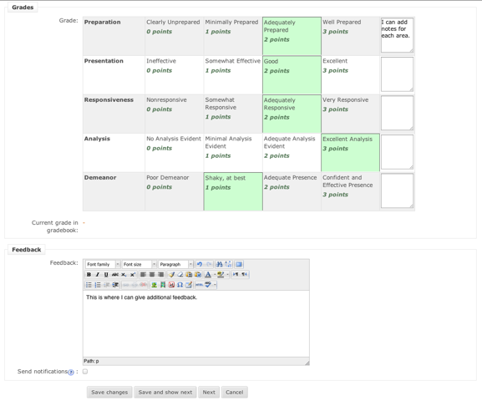
GRADING SIMULATIONS
AND HERE IS HOW THE RUBRIC LOOKS ON THE MOODLE
  I NEEDED SOMETHING QUICK AND FAIR AND HERE IT IS

Slide 33
COURSE GRADING
A MIDTERM, CONSISTING OF 30 MULTIPLE CHOICE QUESTIONS, COUNTED 25 % OF THE FINAL COURSE GRADE
QUIZZES, AS MENTIONED, COUNTED 10 %
SIMULATIONS, AS MENTIONED, COUNTED 15 %
THE FINAL EXAM COUNTED THE REMAINING 50 %
  15 % FOR 60 MULTIPLE CHOICE QUESTIONS
  35 % FOR A 2 ½ HOUR ESSAY
STUDENT COMMENTS REFLECTED SATISFATION WITH BEING ABLE TO STAY ON TOP OF THE MATERIAL THROUGH THESE COMPONENT GRADES
  AND THE BELIEF THAT THE FINAL GRADE AMOUNTED TO A MORE COMPLETE EVALUATION OF STUDENTS’ UNDERSTANDING THAN A GRADE BASED 100 % ON A FINAL EXAMINATION

Slide 34
6. COURSE PAGE

Slide 35
MOODLE IS THE NEW TWEN FOR ME
I DELIVERED THE COURSE TO STUDENTS VIA A MOODLE
  MY TECH CONSULTANT, CRAIG GOLD, SAYS THE INSTALL IS OPEN-SOURCE AND CLOUD HOSTED, WHICH KEEPS COSTS EXCEPTIONALLY LOW AND GIVES SOLID REDUNDANCY
  I HAVE BEEN USING TWEN FOR ALL MY CLASSES SINCE IT CAME INTO EXISTENCE
    BUT I FOUND THE MOODLE FORMAT TO WORK BETTER FOR THIS COURSE, ESPECIALY GIVEN THE QUIZZING BUILT IN WITH GRADING
      I HAVE TRIED TO WORK OUT SUCH QUIZZING ON TWEN, BUT COULD NOT GET THE SAME BENEFITS AS FROM THE MOODLE ENVIRONMENT
    IN FACT, I AM TEACHING MY TRADITIONAL EVIDENCE CLASS THIS FALL WITH QUIZZING COUNTING TOWARD THE FINAL GRADE AND I AM USING THE MOODLE FORMAT FOR THAT CLASS TOO
  THERE WERE NO SIGNIFICANT PROBLEMS WITH THE MOODLE PLATFORM
    THE FEW QUESTIONS THAT STUDENTS HAD WERE EASILY ANSWERED
    IN THE END, ONLY ONE STUDENT COMPLAINED ABOUT THE FORMAT IN THE STUDENT EVALUATIONS
      BUT THAT STUDENT NEVER ASKED FOR HELP AS FAR AS I KNOW
FURTHER THE AFFIANT SAYETH NOT—AKA THE END

